Slide 1


DATA ANALYTICS SHOWCASE
HC-POD 4
HealthConnect Clinic Experience Lab
Reducing Patient No-Shows & Improving Attendance Through Data Insights
KEY TAKE:
Over 51% of clinic appointments are missed. Data was used to fix this.
Presenter: Renish Odhiambo

Slide 2


The Business Problem & Core Objectives
The Problem
Mission
Capacity Waste: High missed visits leave critical clinical staff idle.
Clean and analyze 5,000 appointment records.
Pinpoint exactly why and when patients miss visits.
Blind Operations: Clinic staff lack early warning indicators for no-shows.
Deliver actionable scheduling rules and KPIs.

Slide 3
Core Verified Performance KPIs
BASELINE NO-SHOW RATE
REMINDER LIFT
51.15%
+4.78%
2,423 missed visits out of 4,737 active bookings
Higher attendance when any reminder is sent
SMS PERFORMANCE ADVANTAGE
CRITICAL EXPOSURE
+6.65%
48.40%
Attendance gain over unreminded visits
Appointments booked over 30 days ahead

Slide 4
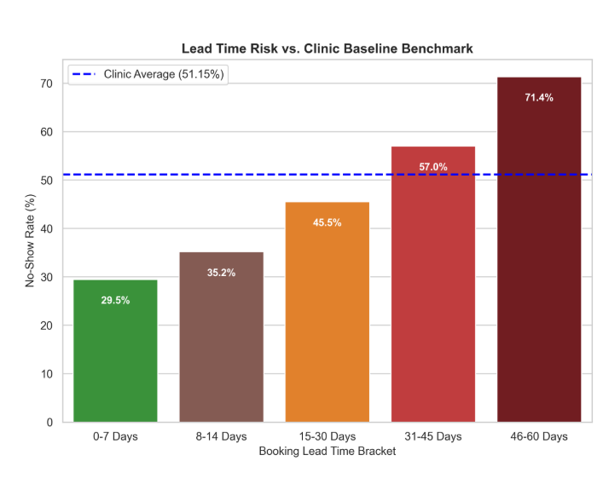

Key Finding 1 : The Lead Time Effect
Analytical Insight
Long booking delays directly cause patients to forget appointments. No-show rates double when lead time extends past 30 days.
Action Trigger Threshold:
Flag all bookings with >31 days lead time for high-touch reminders.

Slide 5
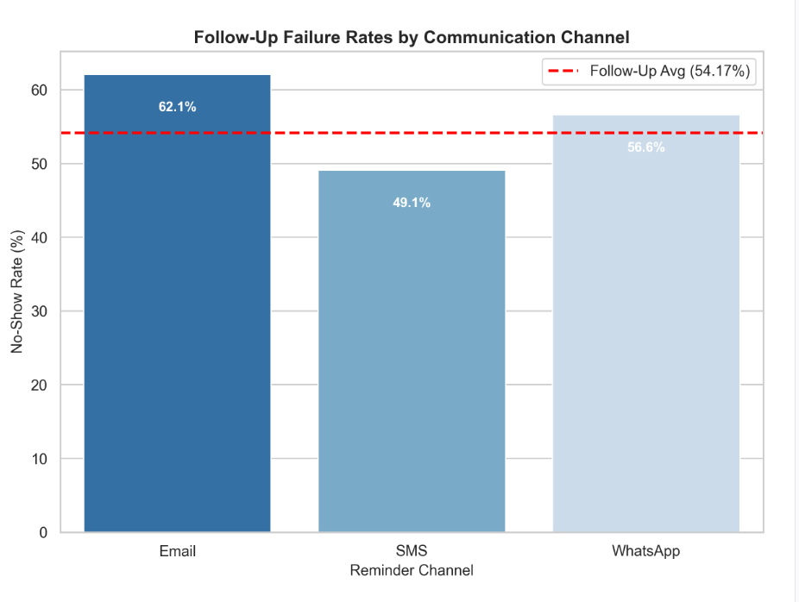
Key Finding 2 : Channel Impact on Follow-Up Visits
PROVEN RECOVERY LIFT
13 out of 100
Missed follow-up visits recovered by switching channel strategy directly from Email to SMS.

Slide 6
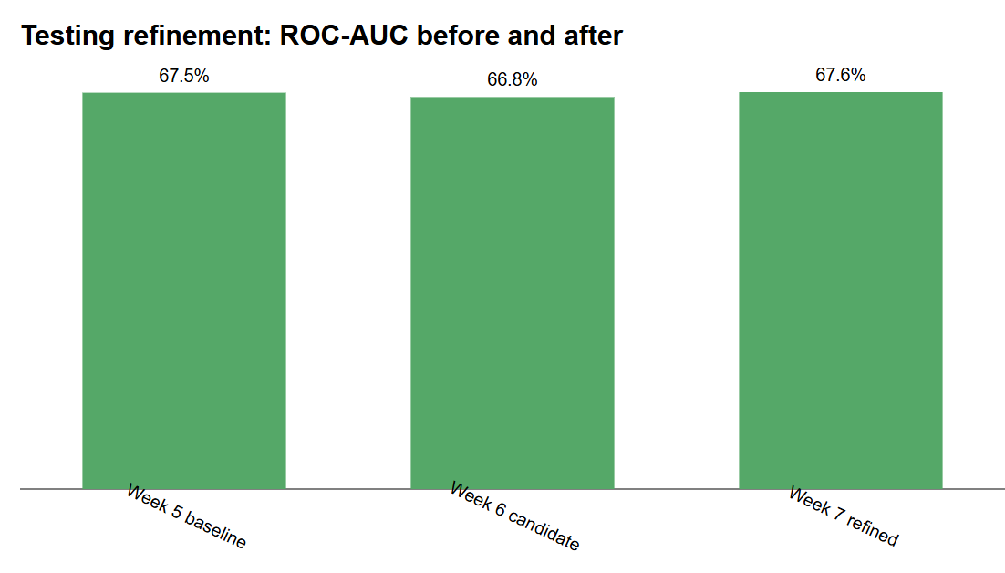

Cross-Track Integration (HC-POD 4)
Data Science Integration
Collaborator: M’bengue Mama
Empirical Risk Thresholds: Analytics supplied rule bounds (lead_days > 30 and past_no_shows ≥ 2).
Predictive Feature Recall: Data Science built features achieving 99.8% recall on long-lead visits.
Population Consistency: Test results (n=1,903) matched analytics numbers within 0.3%.

Slide 7
Actionable Business Recommendations
01
Two-Stage SMS Reminders
02
SMS-Only Follow-Up Policy
Automated SMS alerts at 7 days and 48 hours for bookings >21 days old.
Discontinue email reminders for follow-up appointments immediately.
03
24-Hour Standby Pool
04
Chronic Caller Protocol
Move unconfirmed long-lead bookings to walk-in patients 24 hours prior.
Flag patients with 2+ past missed visits for direct phone contact.

Slide 8
Business Value & Closing Next Steps
Clinical Value
Patient Experience
Next Steps
Recovers unused doctor hours and cuts direct revenue leakage.
Provides timely reminders and frictionless rescheduling options.
Real-time SMS delivery tracking & pediatric data integration.

